Slide 1
Installation of Linux on VMWARE
Lab 3
FAHAD BURHAN AHMAD

Slide 2
Prerequisites To Install Linux On VMWare Workstation
A host system with minimum:
8 GB of memory
A quad core CPU
256GB of Hard Drive
VMWare Workstation Pro or Player application:
Download VMWare Workstation
Operating System to install on VMWare Workstation:
Download Kali Linux

Slide 3
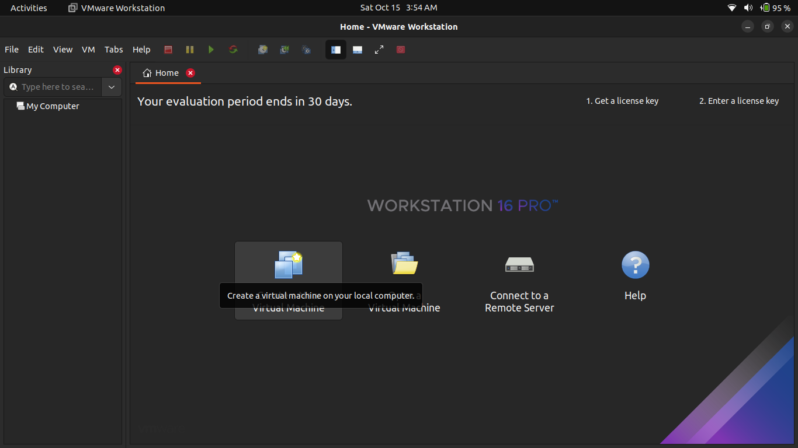
How to Install Kali Linux on VMWare Workstation?
Open VMWARE Workstation and click on Create a new VM

Slide 4
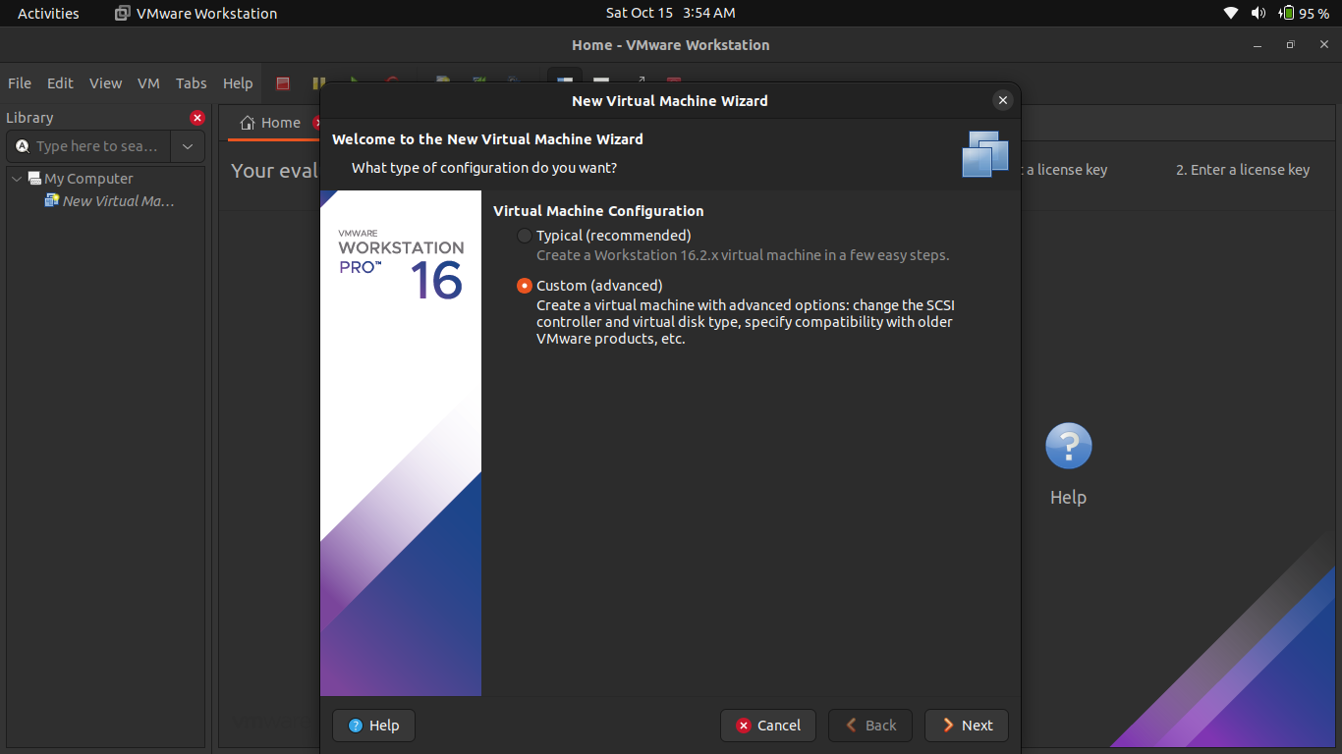
Select Custom Configuration Wizard You can choose either Typical or Custom Wizard. We recommend selecting Custom if you want to install with all the configurations.

Slide 5
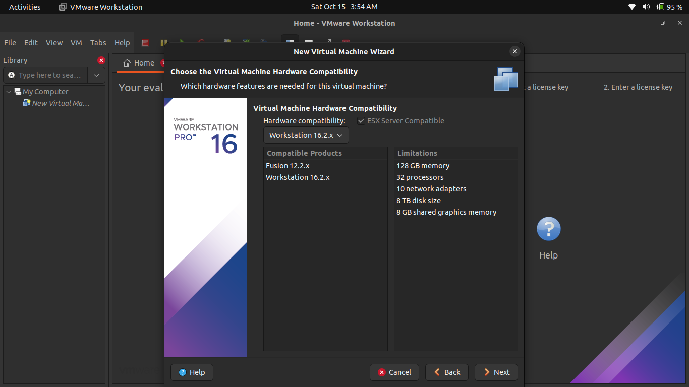
Select VM Hardware Compatibility – Press Next Go with the default option

Slide 6
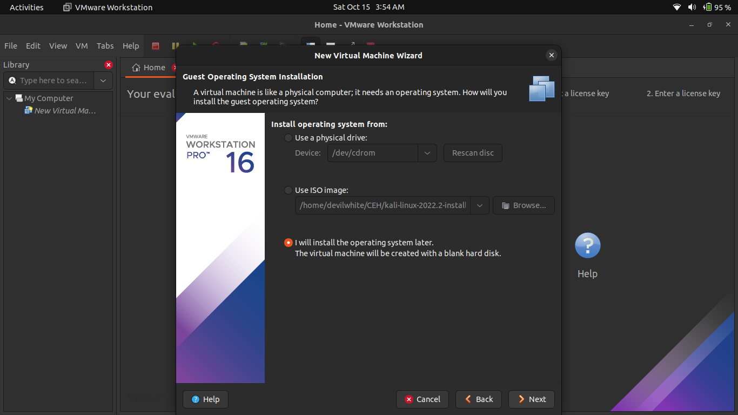
Select the Operating System Media Select I'll Install OS later and click on Next.

Slide 7
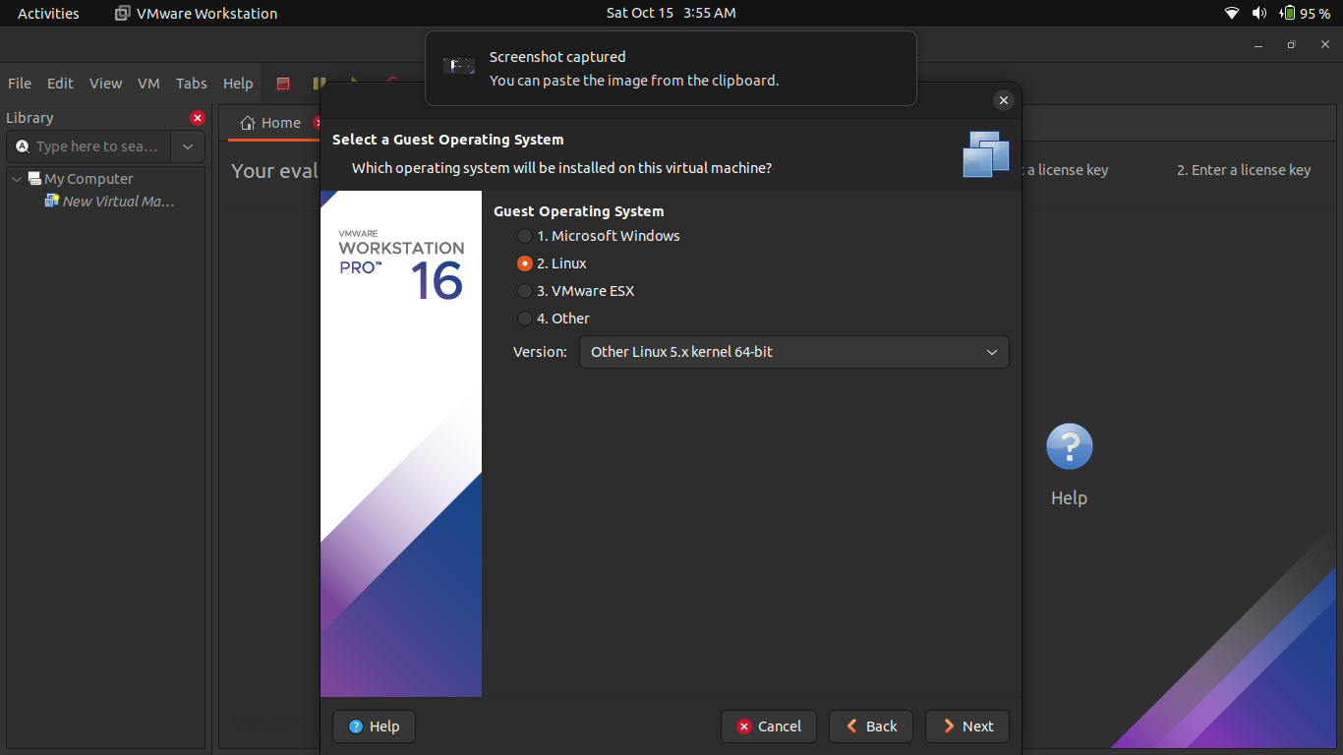
Select Guest Operating System Select version Other Linux 5.x kernel 64-bit

Slide 8
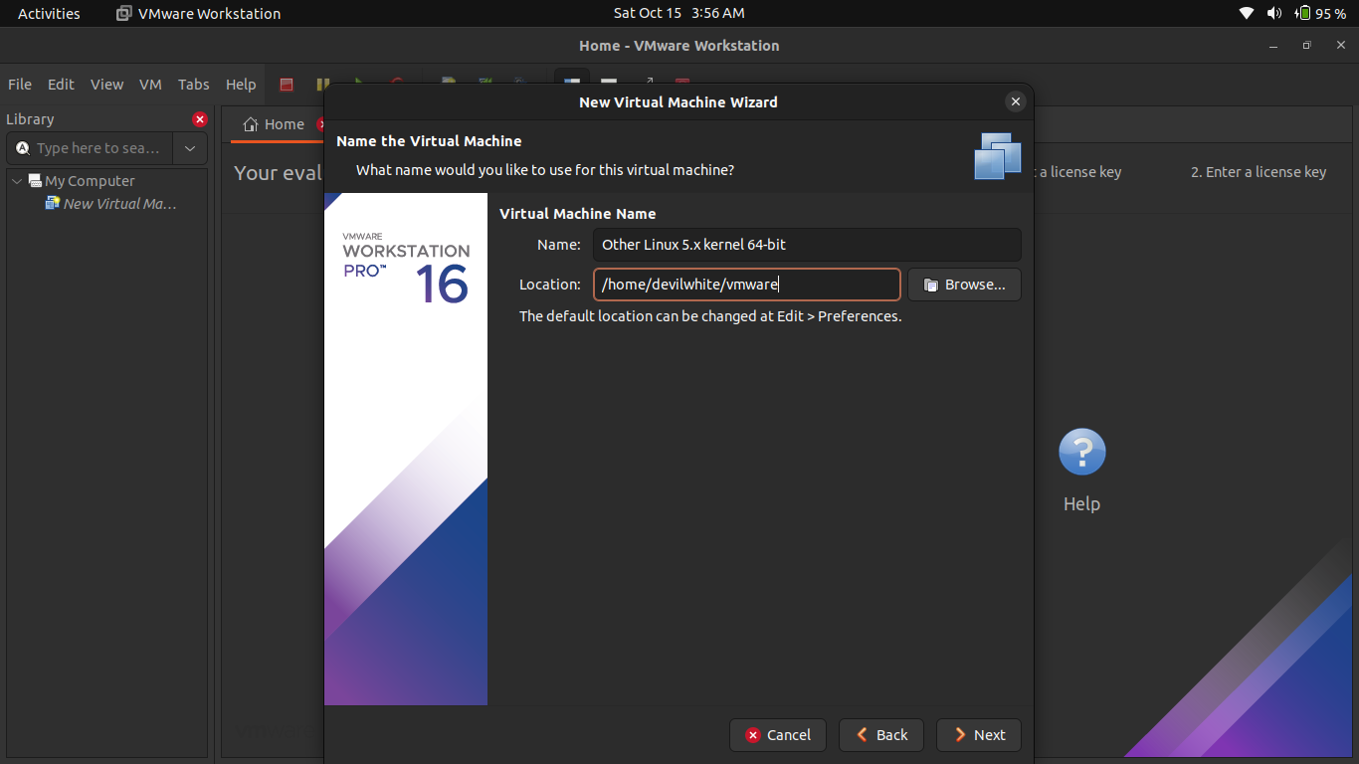
Name the VM and Browse Location

Slide 9
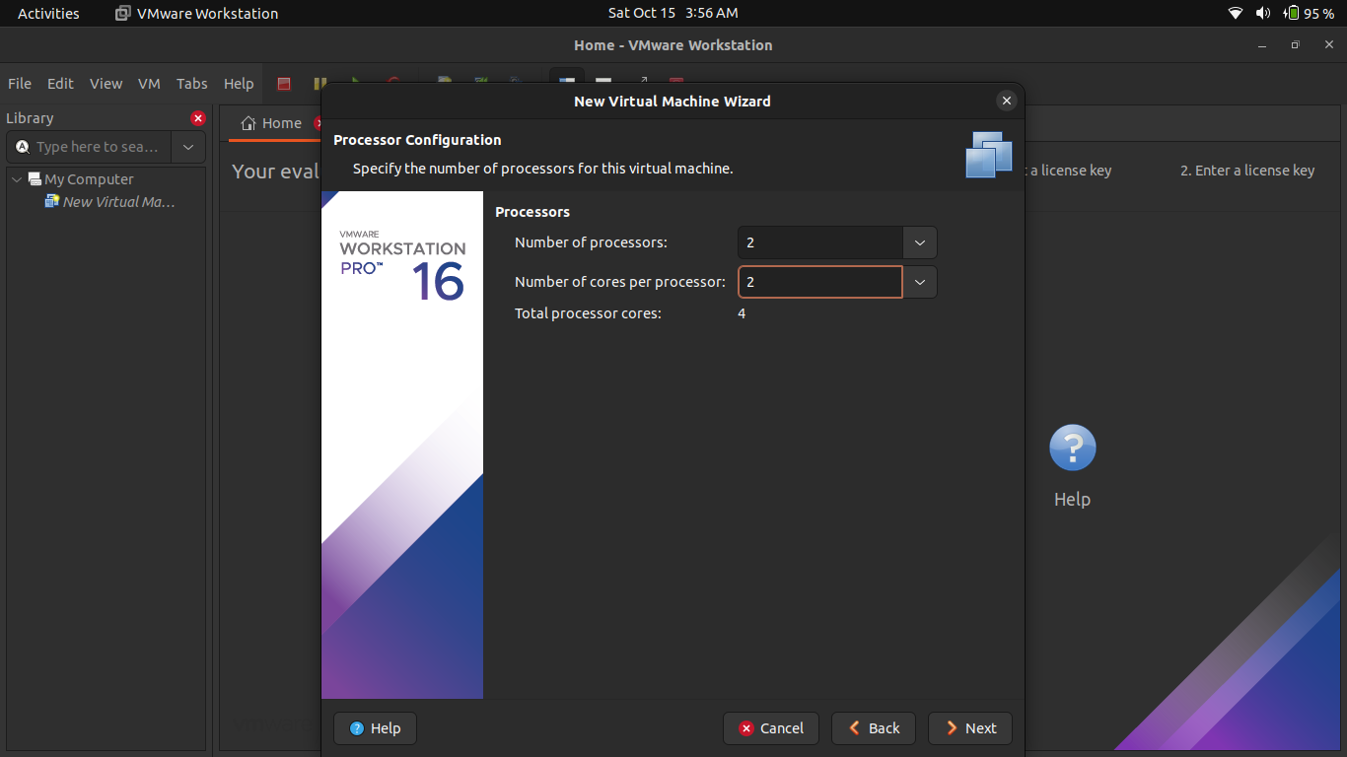
Allocate the Processor

Slide 10

Allocate the Memory for VM Leave sufficient memory for the host system and allocate the remaining memory for the virtual machine.

Slide 11
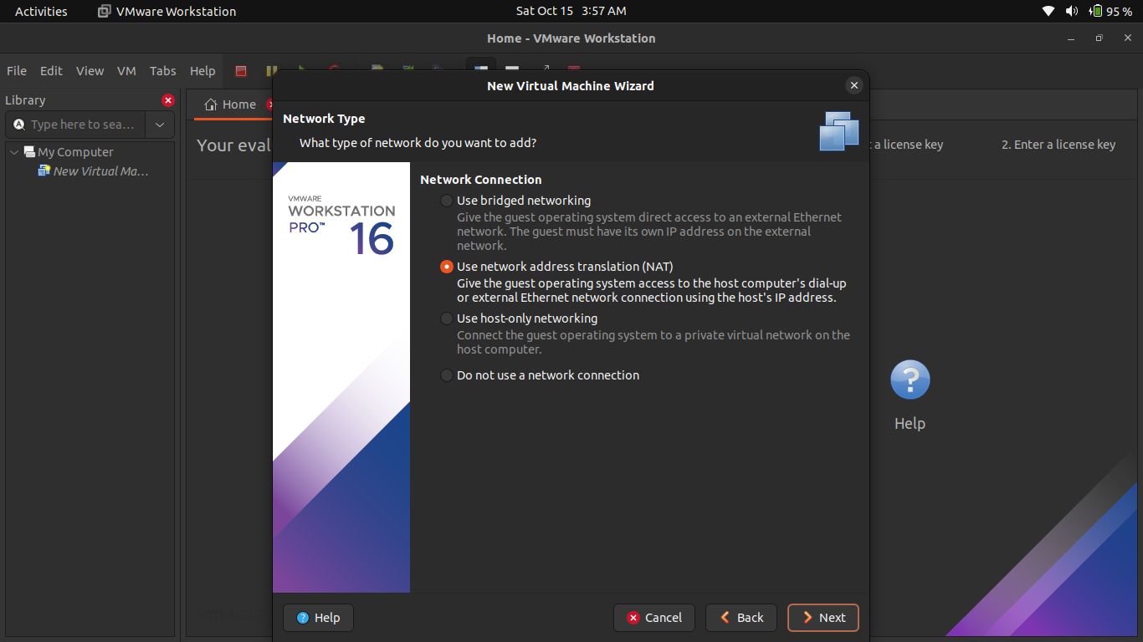
Choose Network Configuration Select any one of the network configurations as per your requirement.

Slide 12
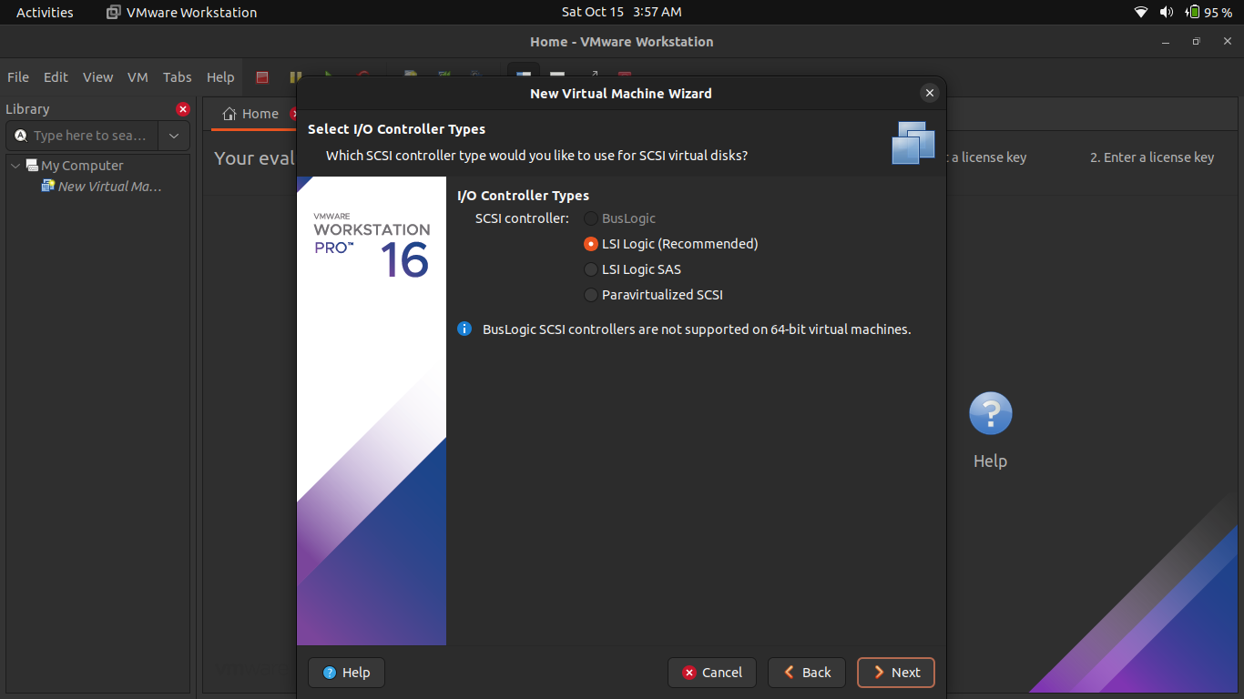
Select the I/O Controller Type

Slide 13
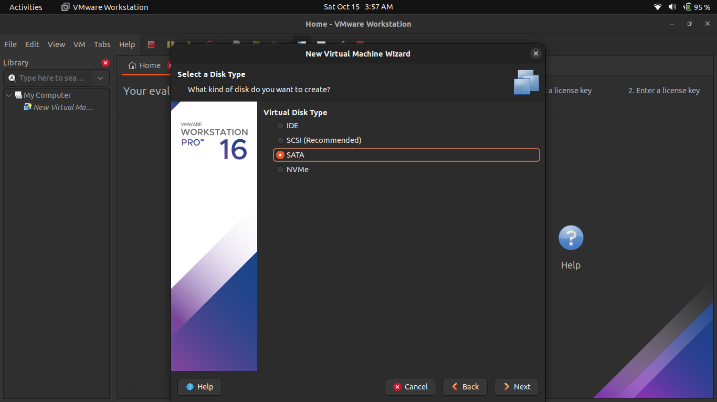
Select Disk Type – SATA

Slide 14
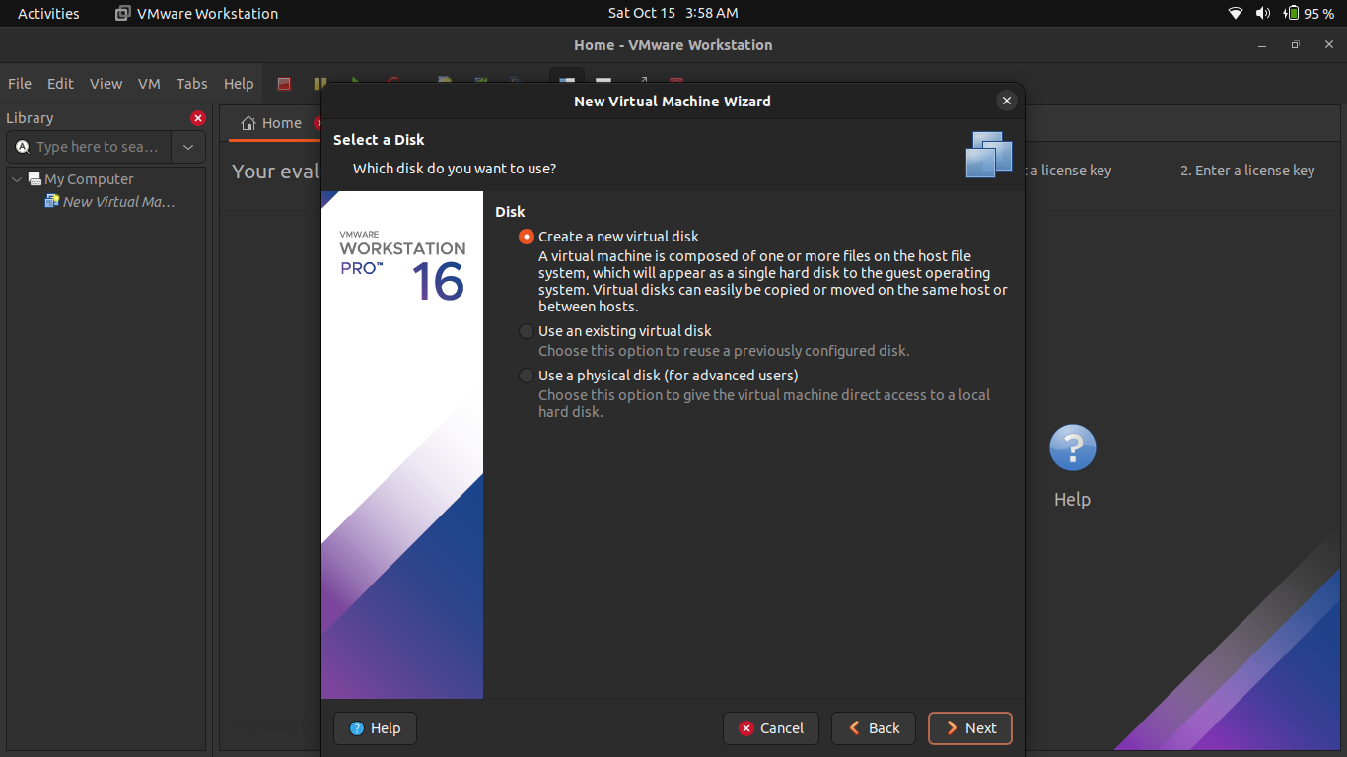
Select Virtual Disk Select the Virtual Disk if you have or create one.

Slide 15
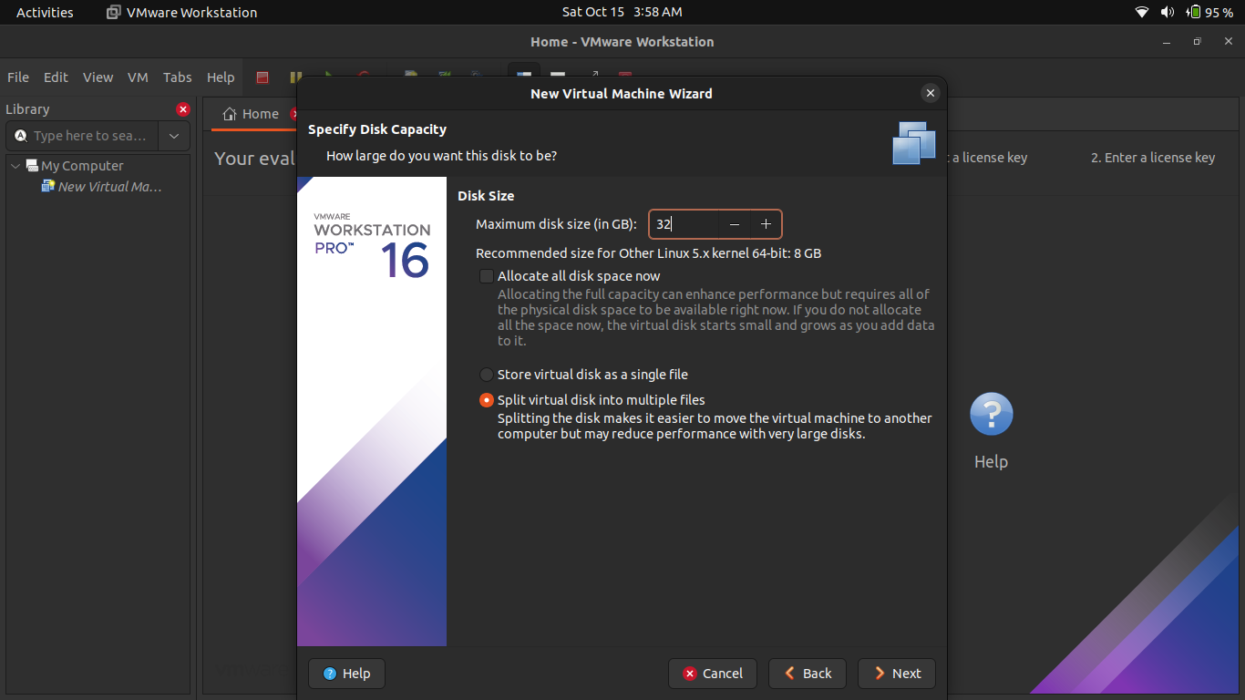
Select Disk Capacity Select the disk size. Selecting a single disk will increase the performance. However, selecting a split disk will help in the disk transfer scenario.

Slide 16

Specify Virtual Disk File Provide the File name you want. I.E. Linux

Slide 17
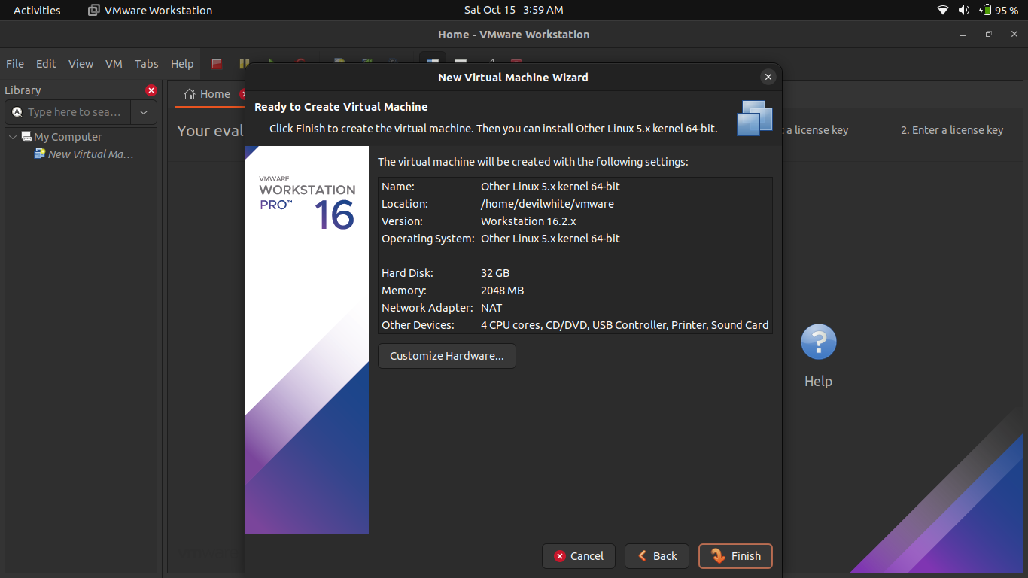
Create Virtual Machine Click on Finish.

Slide 18
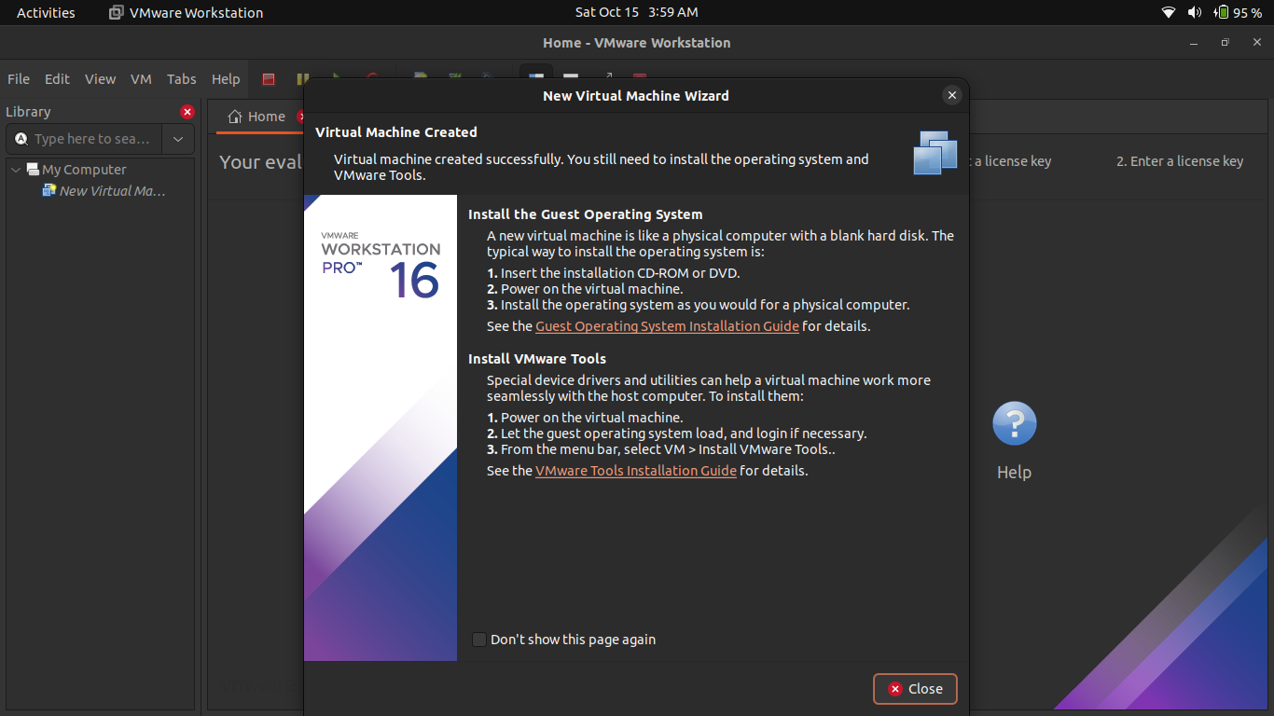
Create Virtual Machine Click on Close.

Slide 19
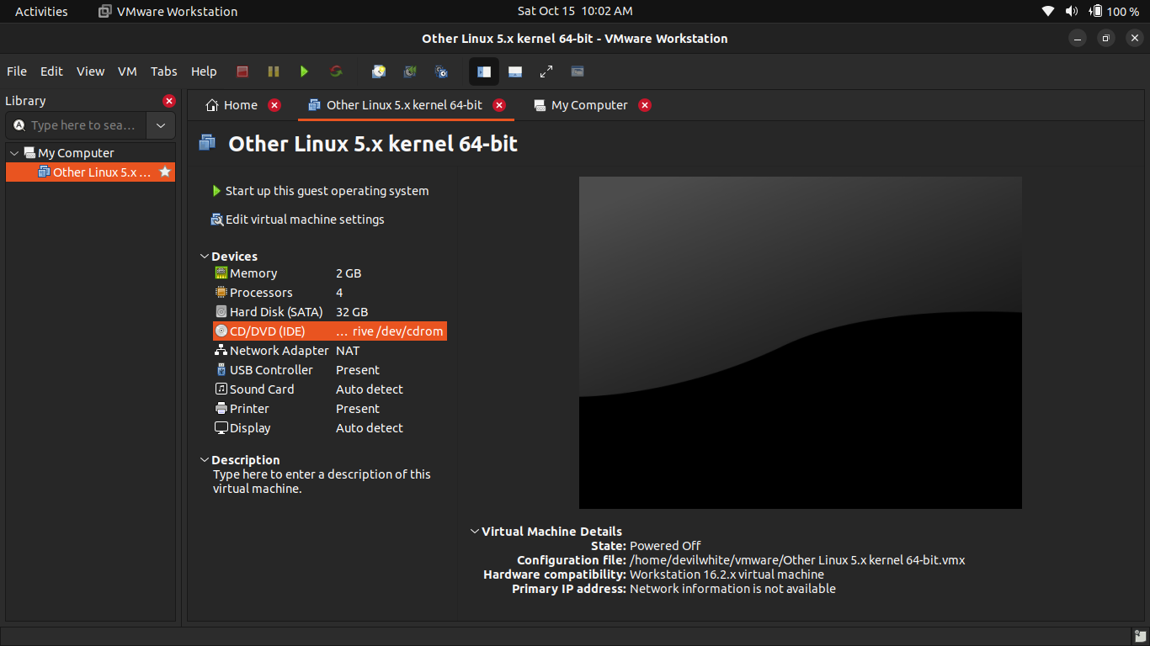
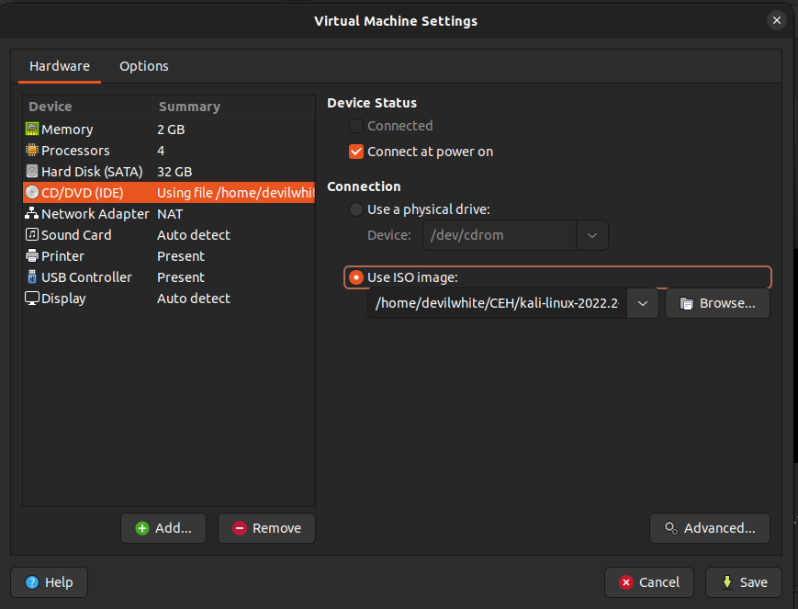
Supply Kali Linux ISO Image to Virtual Machine Double click on CD/DVD settings and import the downloaded Kali Linux image.

Slide 20
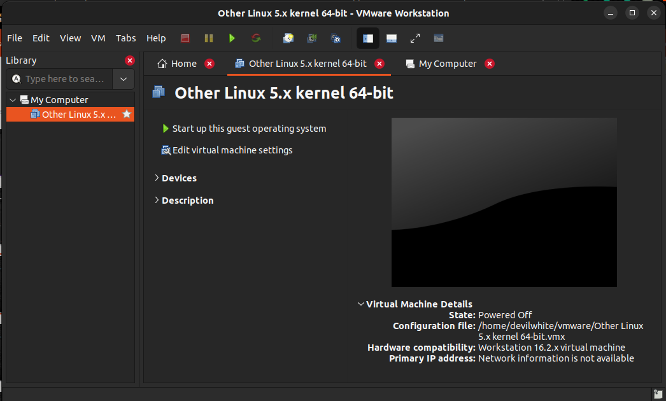
Power On the Virtual Machine

Slide 21
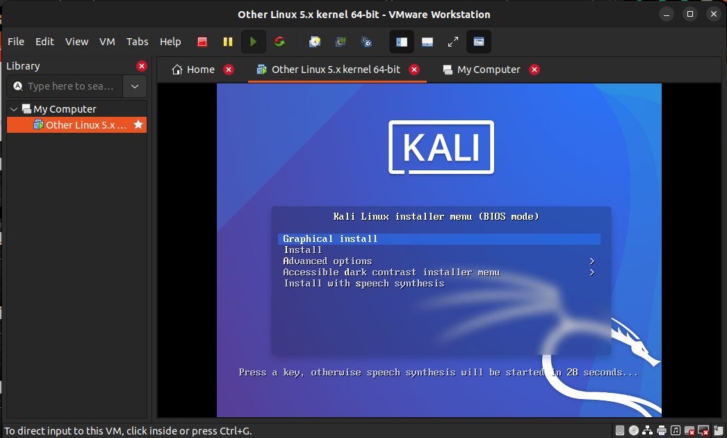
Install Kali Linux – Click on Graphical Install

Slide 22
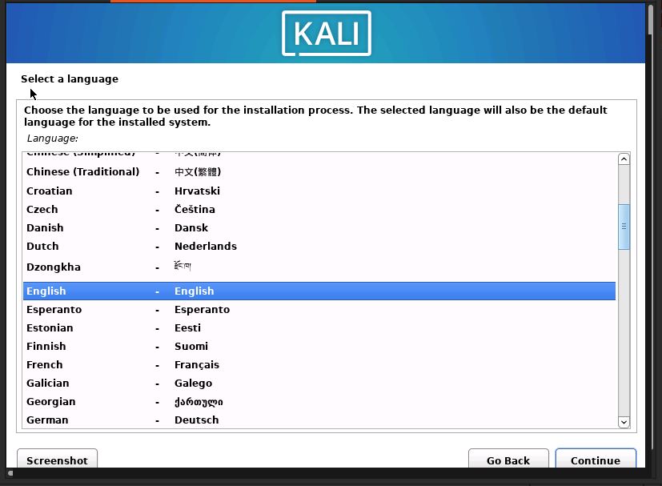
Welcome Kali Linux VM – Select Language

Slide 23
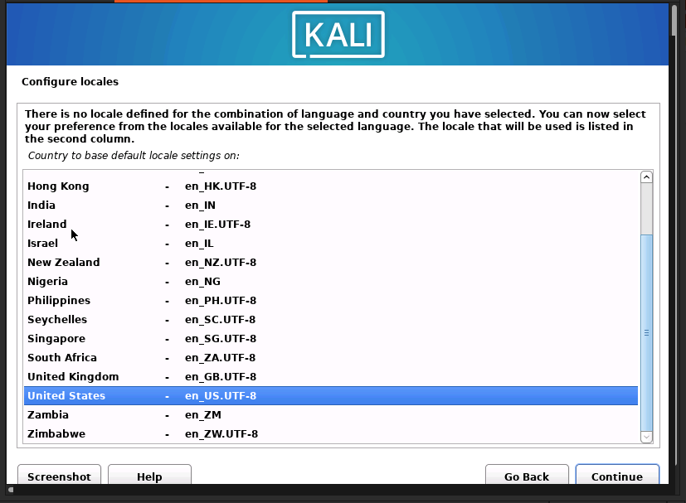
Select Location – Other -> Asia -> Pakistan

Slide 24
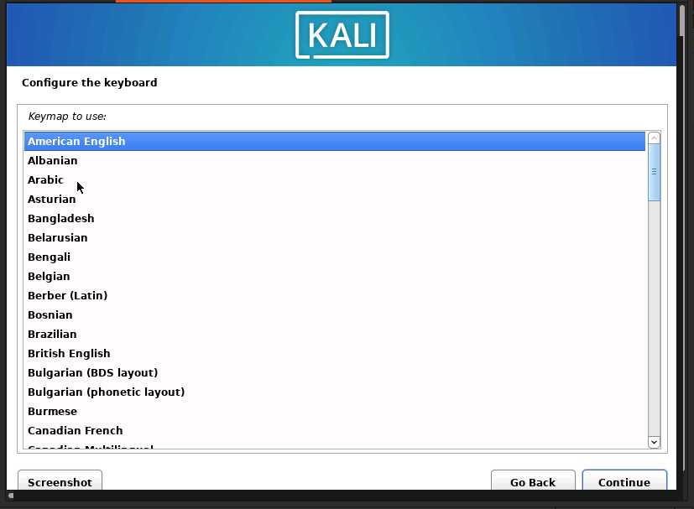
Select Keyboard Layout --> American English

Slide 25
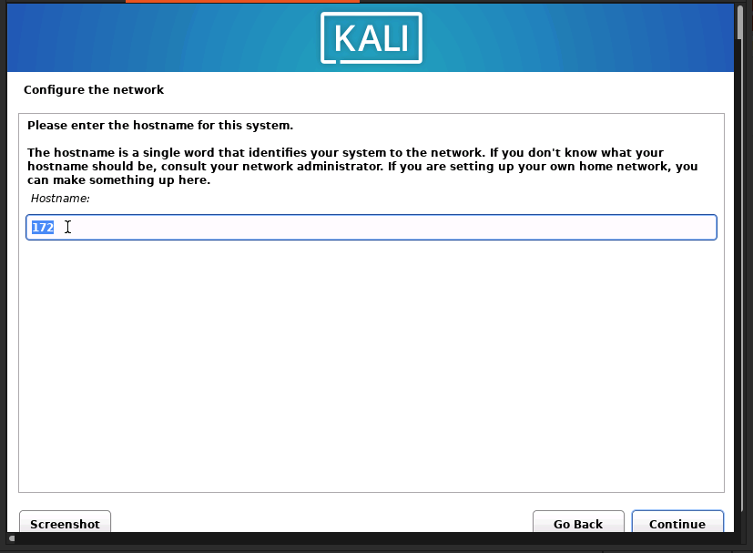
Enter Host Name for your Linux

Slide 26
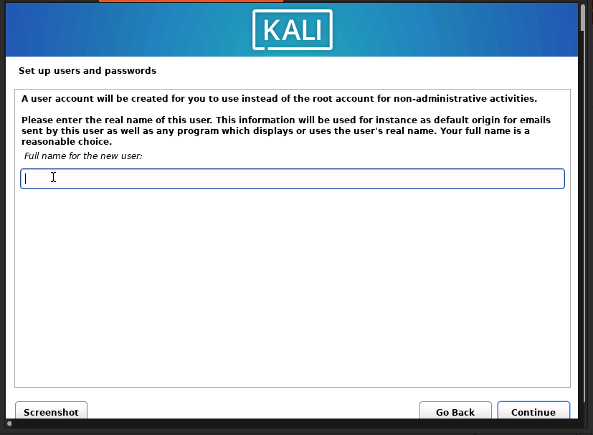
Set up a user account and password

Slide 27
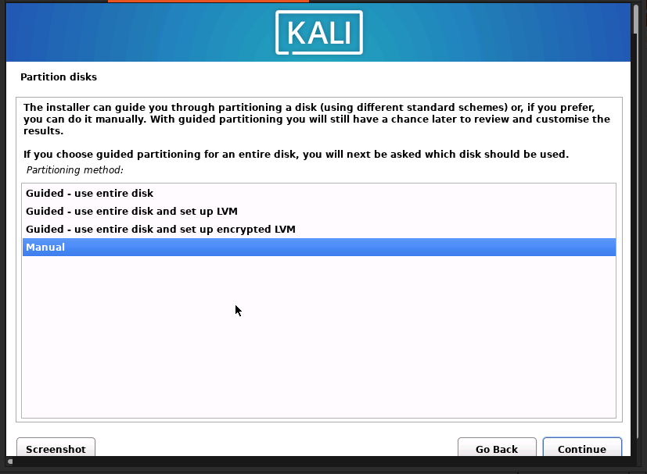
Disk Partition – Click On Manual

Slide 28
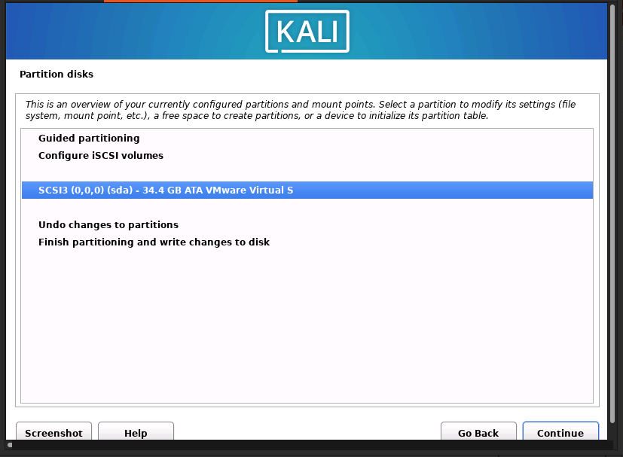
Disk Partition – Select Disk

Slide 29
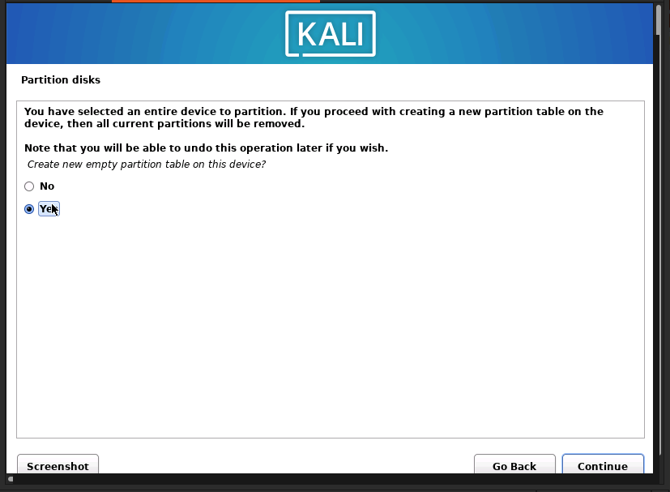
Partition Disk

Slide 30
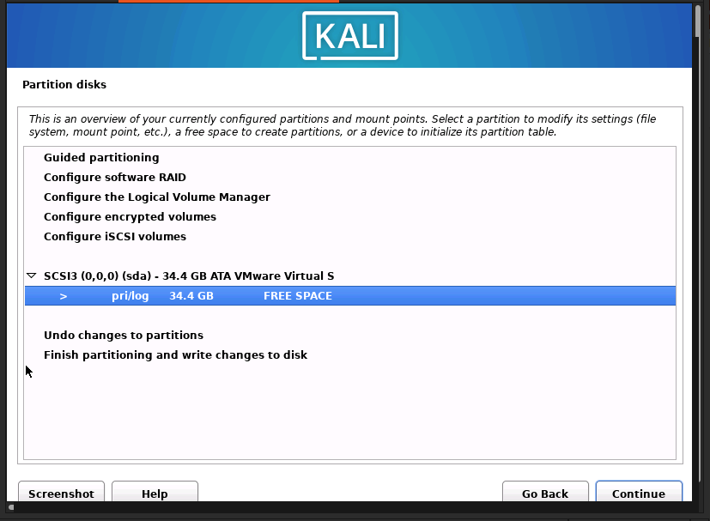
Partition Disk – Double Click on Partition

Slide 31
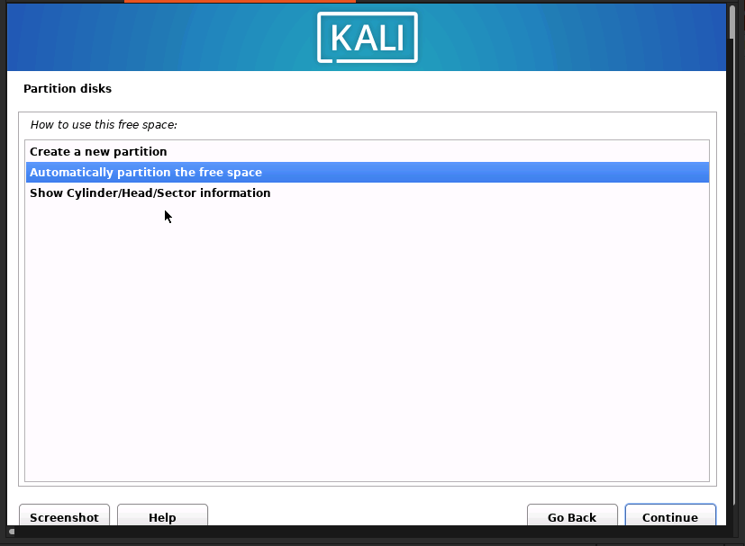
All Files In One Partition (recommended for new users)- Continue
1st
2nd

Slide 32
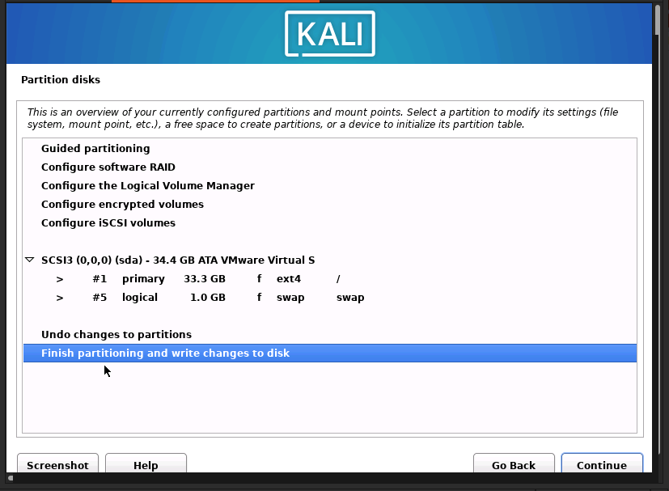
Partition Disk – Finish Partitioning and write changes

Slide 33
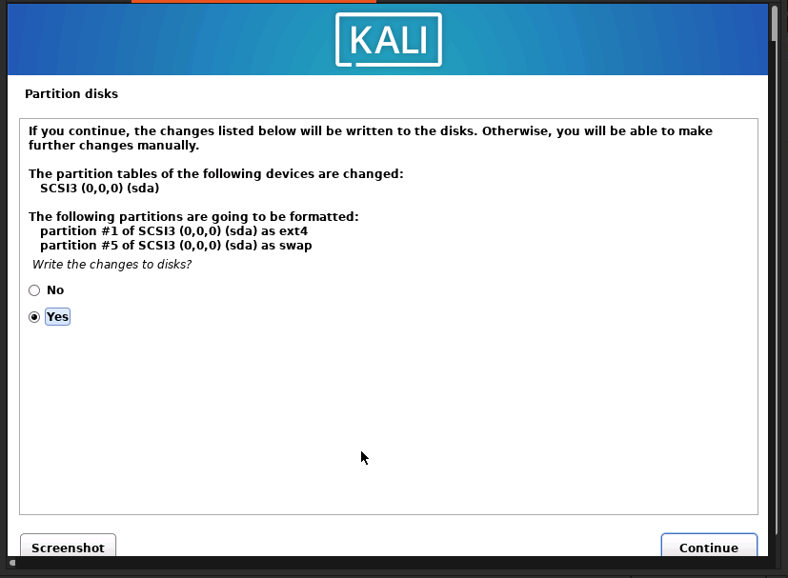
Partition Disk – Choose Yes

Slide 34
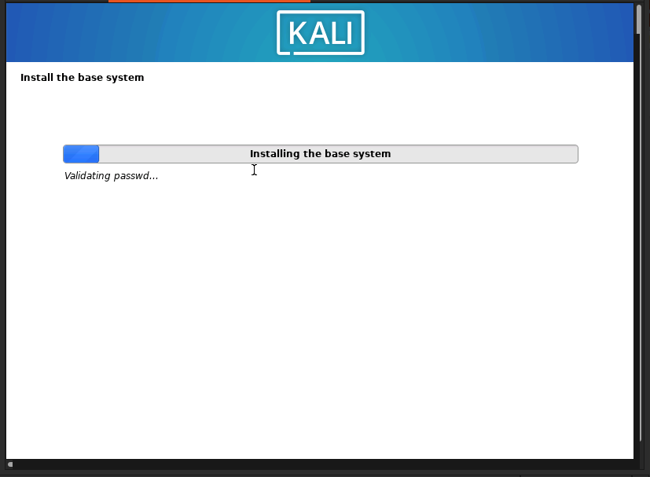
Installation Screen

Slide 35
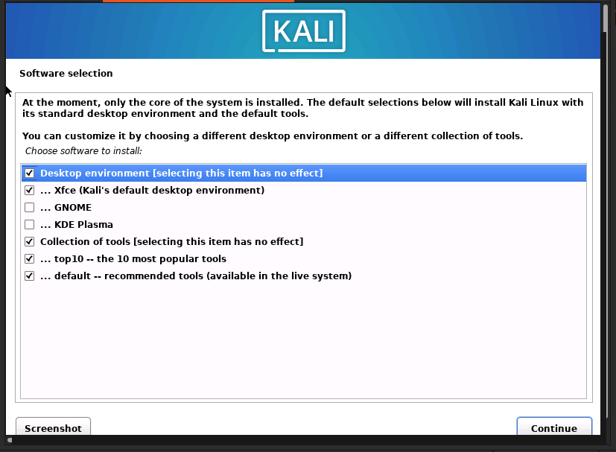
Select Software Packages according to Needs – Click on Continue

Slide 36
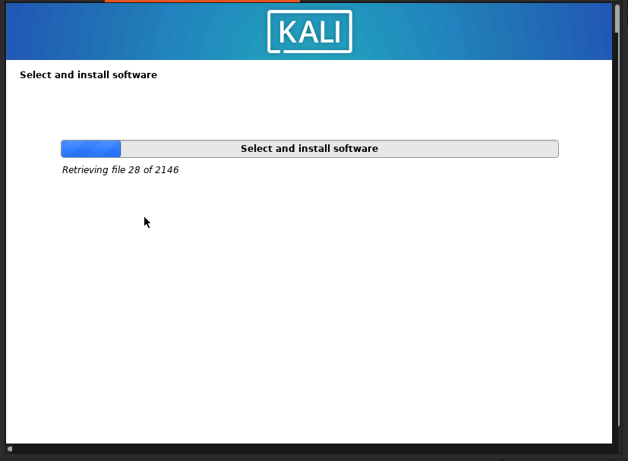
Installation of Kali Linux in Progress

Slide 37
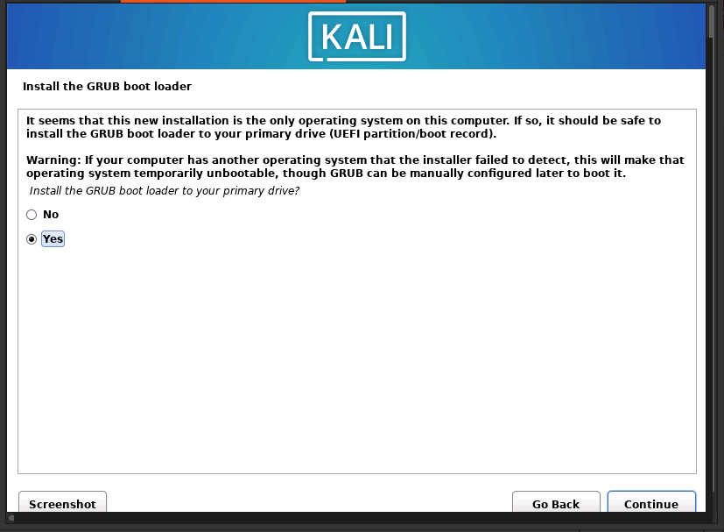
Install the GRUB boot loader

Slide 38
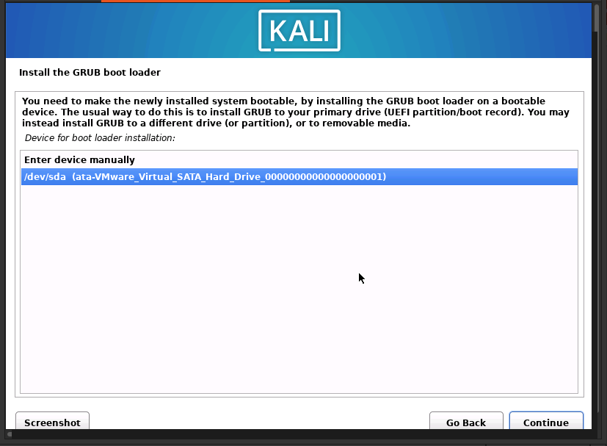
Select the Drive to install GRUB

Slide 39
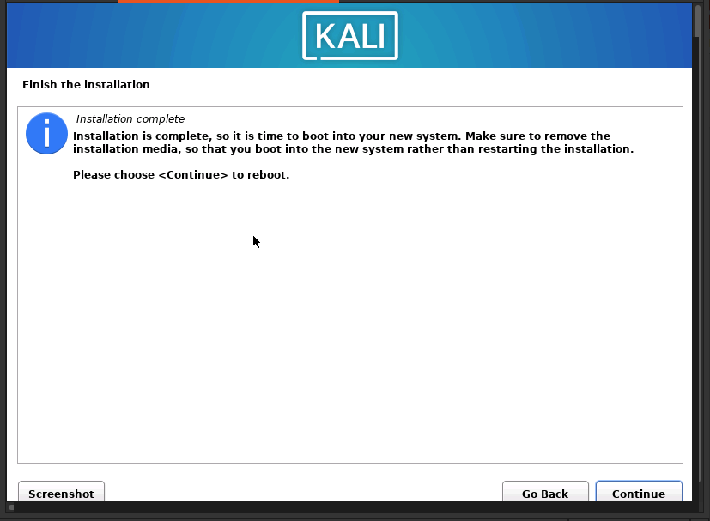
Installation Procedure of Kali Linux has Finished – Click Continue

Slide 40
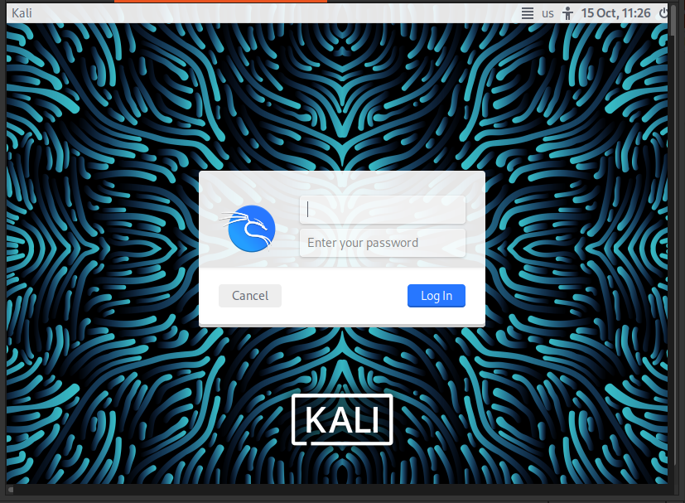
Login to the Kali Linux with the user account

Slide 41
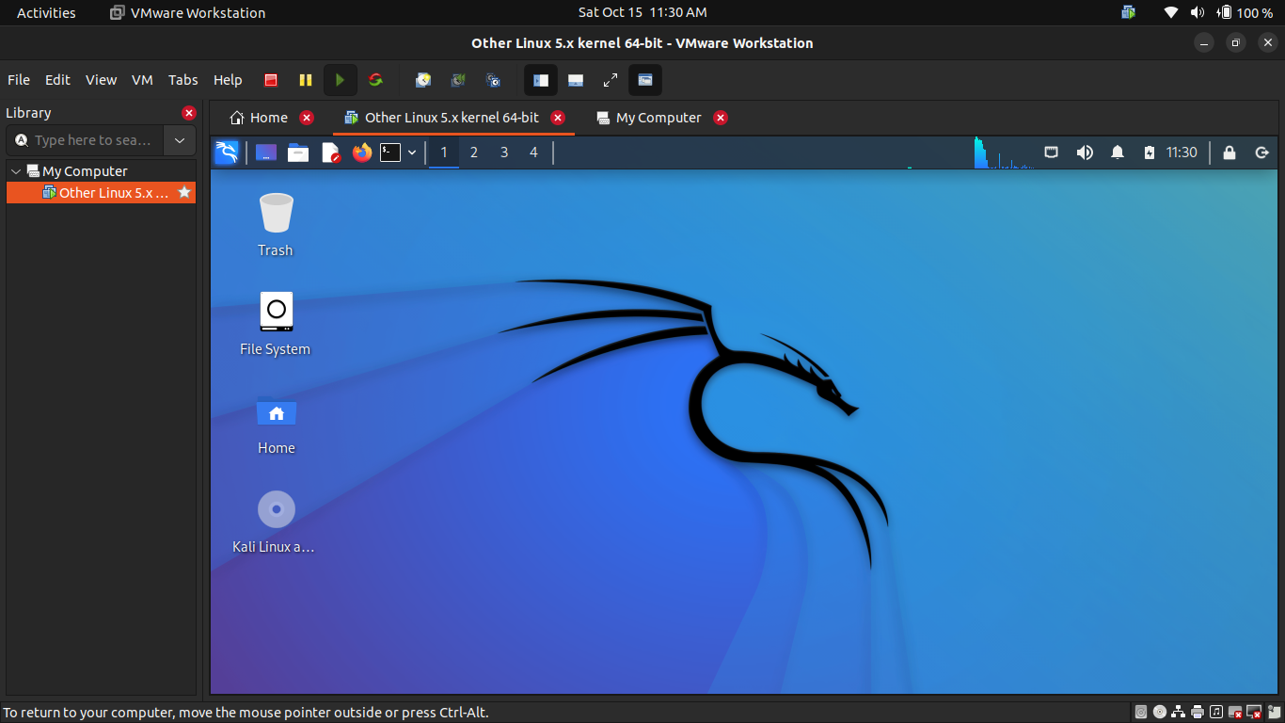
Kali Linux Desktop after login

Slide 42
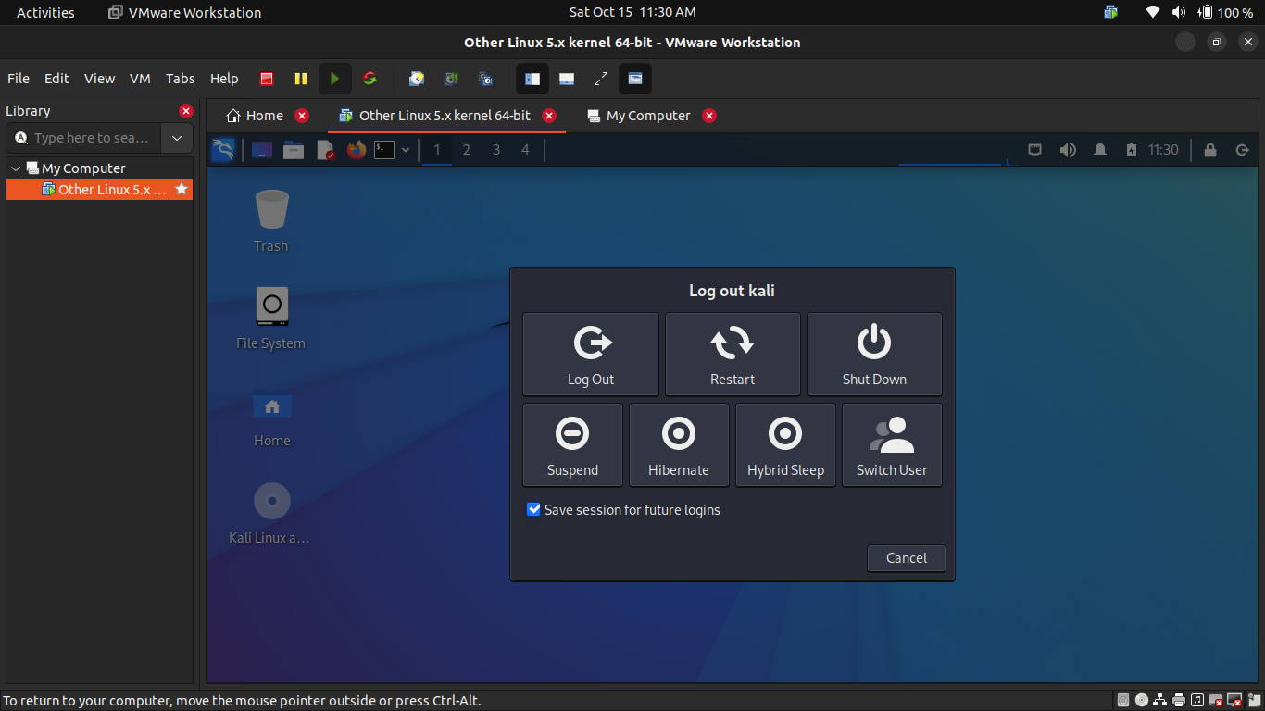
Shut Down Kali Linux

